Slide 1


Slide 2
Creating a Data Informed Culture

Slide 3
The Gartner Analytic Continuum
Descriptive Analytics
Diagnostic Analytics
Predictive Analytics
Prescriptive Analytics
What Happened?
Why did it happen?
What will happen?
How can we make it happen?
Foresight
Insight
Value
Hindsight
Difficulty

Slide 4
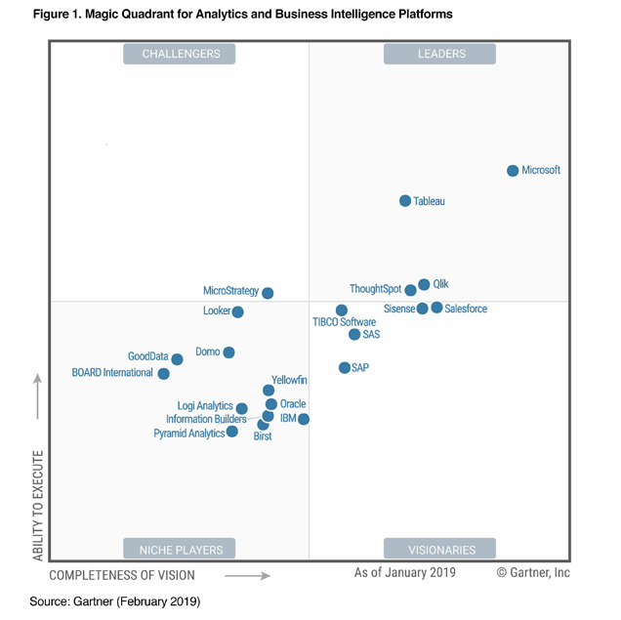
Microsoft’s Business Intelligence Platform
SSIS: SQL Server Integration
SSRS: SQL Server Reporting
SSAS: SQL Server Analytics
PowerBI: Visualization, data exploration, dashboards

Slide 5

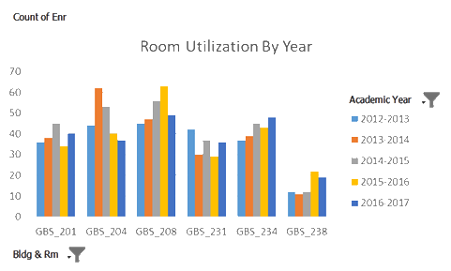


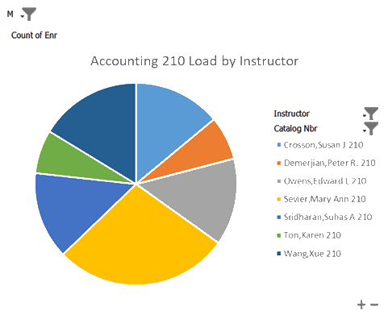
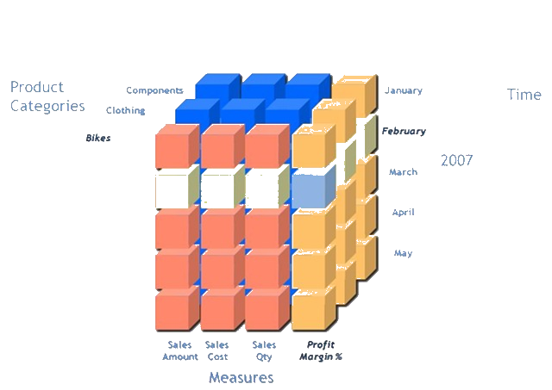
GBSBIA Tools and Methods: ====> Remember: Analytics is Software
- Institutional (Emory) Data
- Augment with School (GBS) Data
- Overlay with External Data
- ETL Toolkits – SSIS, SQL and HaloBI
- C# Programming & R Regressions
- OLAP Cubes with SSAS
- SSRS Reporting on SharePoint
- MS Excel for Cube Exploration
- Microsoft PowerBI for Dashboards
Flatfiles
Source RDBMS
Cloud Data
SSAS Cubes
DEV / TEST / PROD

Slide 6
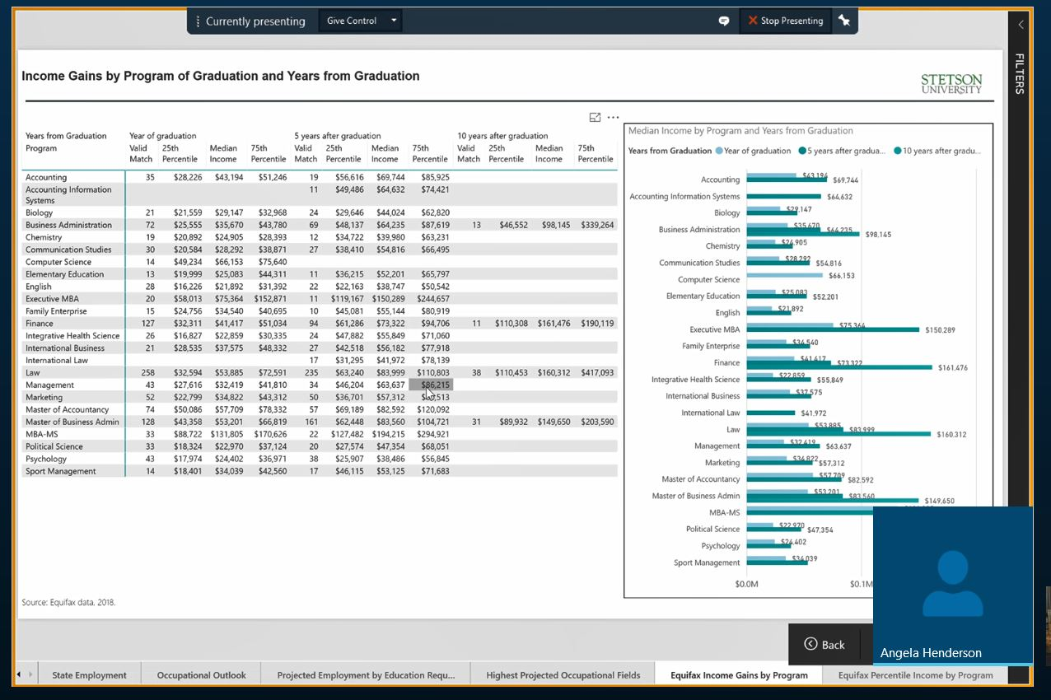
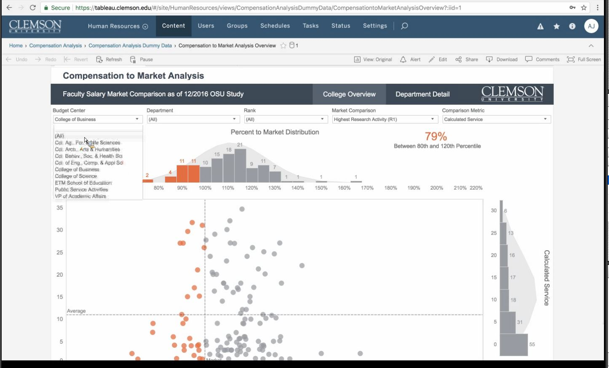
Learning from Stetson & Clemson
Clemson: Compensation to Market
Stetson: Income Gains by Program

Slide 7
Most Significant Learning from our Peers
Work with a team of three:
Data warehouse expert
Data visualization expert
Subject Matter Expert

Slide 8
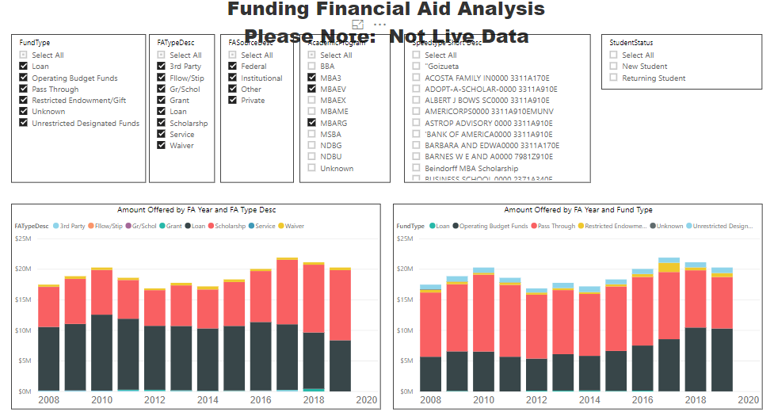
Sample PowerBI Dashboards
PowerBI Dashboard #1: Financial Aid Analysis
Note A: Since ~2016, we’ve seen a decrease in MBA students utilizing federal loans, and an increase in students utilizing scholarships
Note B: At the same time, we’ve seen a significant increase in operational budget funding of the scholarships, but no commensurate increase in endowment funding of scholarships
“Is this intentional – or a market shift?”
A
B

Slide 9
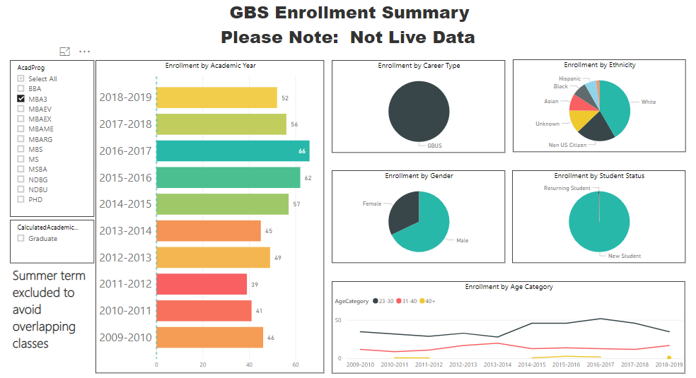
Sample PowerBI Dashboards
PowerBI Dashboard #2: Enrollment Analysis
Note A: Since ~2016, we’ve seen a decrease in the number of students age 23-30 enrolling in our 1 year MBA program
Since ~2017, we’ve seen an increase in the number of students age 30-40 enrolling in our 1 year MBA program
“Is this intentional – or a market shift?”
A

Slide 10
Let’s Build a Dashboard!!! (but first pick an interesting data set)
https://implicit.harvard.edu/implicit/selectatest.html
Get the data here: https://osf.io/uvdbj/
Don’t worry about taking notes. I’ll give you a link to my GIT Repo.

Slide 11
Software Requirements
PSPP – the Open Source SPSS: https://www.gnu.org/software/pspp/get.html
Notepad++ or GVIM – something to inspect large text files: https://notepad-plus-plus.org/download/v7.6.6.html
SQL Server Developer Edition: https://www.microsoft.com/en-us/sql-server/sql-server-downloads
Sql Server Management Studio: https://docs.microsoft.com/.../clickme
Visual Studio Community Edition: https://visualstudio.microsoft.com/downloads/
SSIS for Visual Studio: https://marketplace.visualstudio.com/items.../clickme
PowerBI: https://powerbi.microsoft.com/en-us/downloads/

Slide 12
Prepare the Data
ETL – Extract / Transform / Load

Slide 13
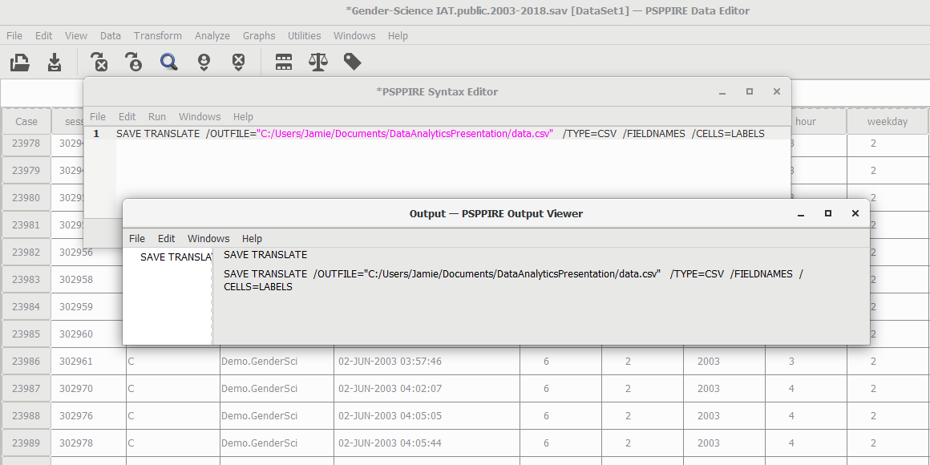
Convert the SPSS file to CSV
Launch PSPP
SAVE TRANSLATE /OUTFILE=“c:/Path/to/out” /TYPE=CSV /FIELDNAMES /CELLS=LABELS
Options:
/OUTFILE ➔ Output file name
/TYPE=CSV ➔ Save as CSV
/FIELDNAMES ➔ Output header line
/CELLS=LABELS ➔ Output “word values”

Slide 14
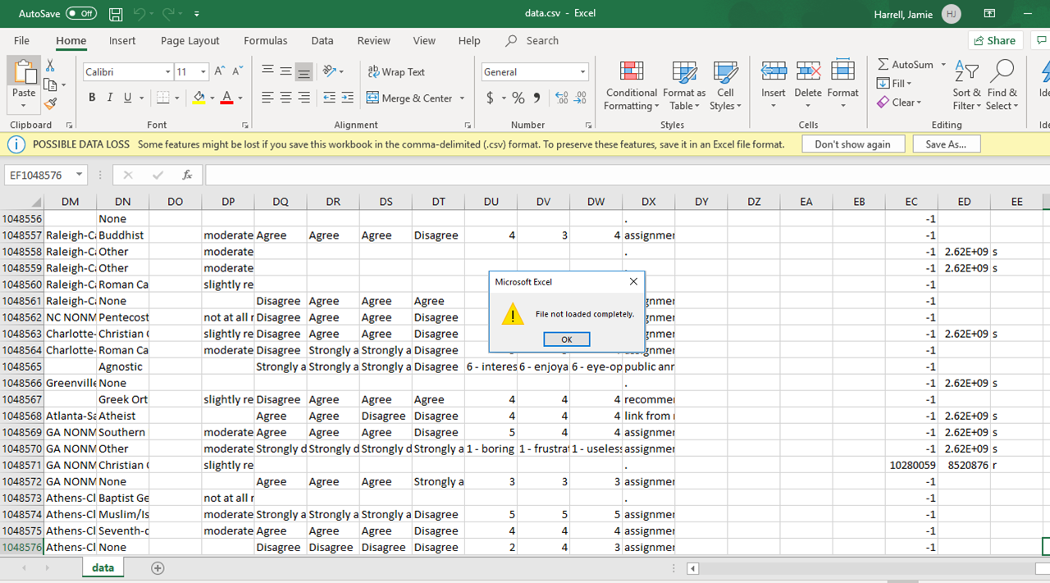
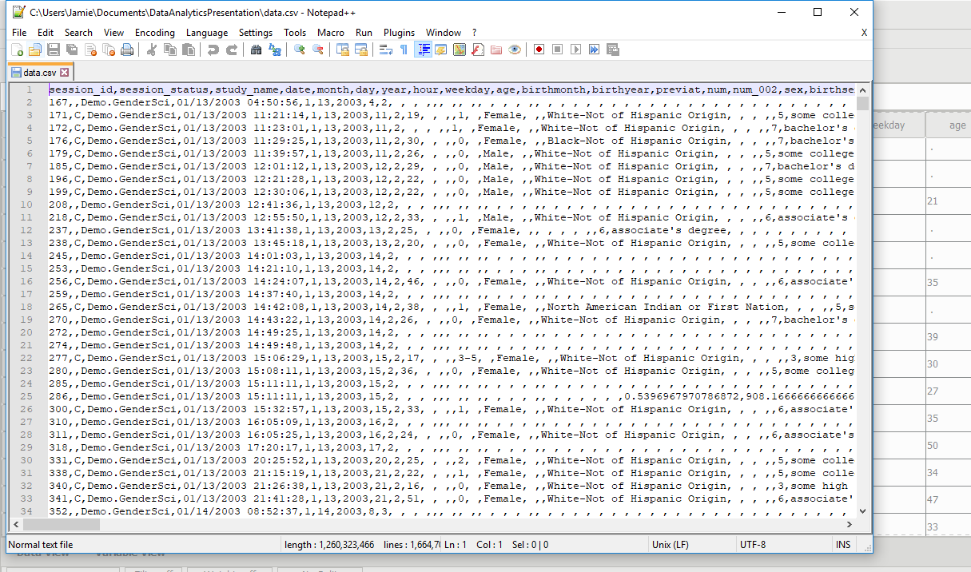

Explore the Data with NotePad++
NEVER USE EXCEL AND EXPECT GOOD RESULTS. NEVER SAVE A CSV FILE AFTER OPENING IT IN EXCEL!
Header line with field names
Some data is quote-enclosed
Values are output, not just numerics
Empty fields are represented
Most importantly: 1,664,708 lines
Header line
Blank last line
➔ 1,664,706 data rows

Slide 15
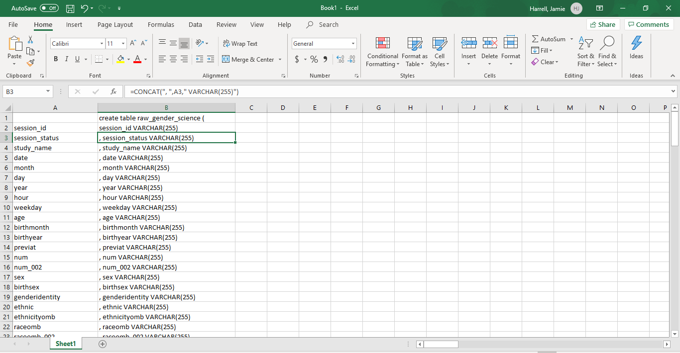
Use Excel to generate Create Table command
Copy Field Names from first line of file
Paste-transpose into rows
Use CONCAT() function to generate a Create Table SQL Statement
Fix the invalid fields names along the way. Eg, you can’t use the field name “order” in a table directly
Plug this into both Visual Studio Database Project and “Publish” it to your database, or just run the SQL in SQL Server Management Studio

Slide 16
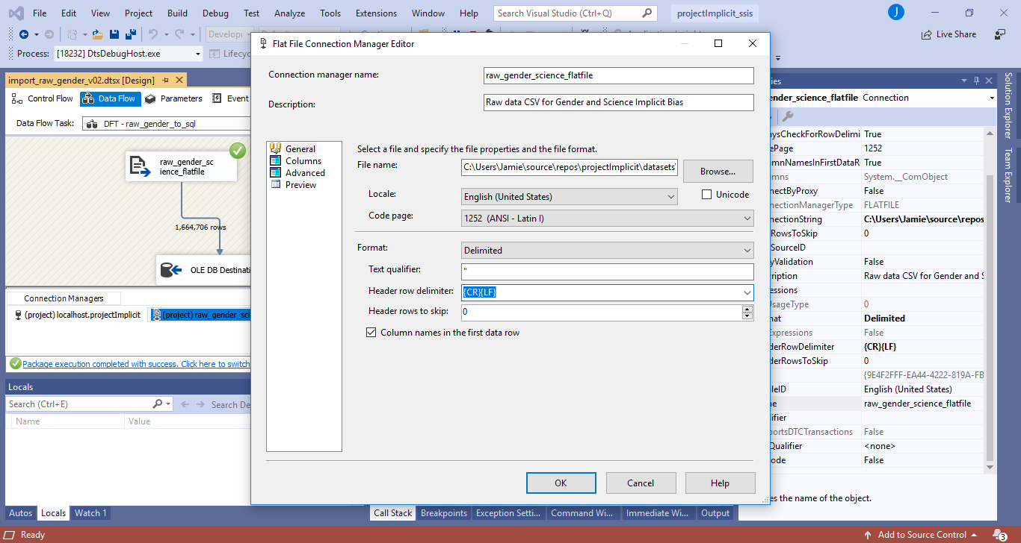
Visual Studio SSIS project package: load raw data
Our goal is to get the CSV file loaded into SQL server for manipulation and visualizations
Control Flow Tasks create “ordered” actions – or in simple terms, programs
Truncate the table
Load CSV into SQL table
Data Flow Tasks move data from one location to another
Read from a Source (CSV File)
Write To a Destination
Map columns data in ➔ data out
Execute the Package to truncate and load the data into the SQL Server table

Slide 17
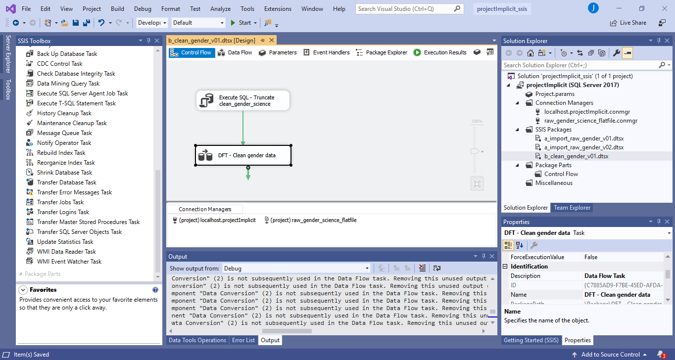
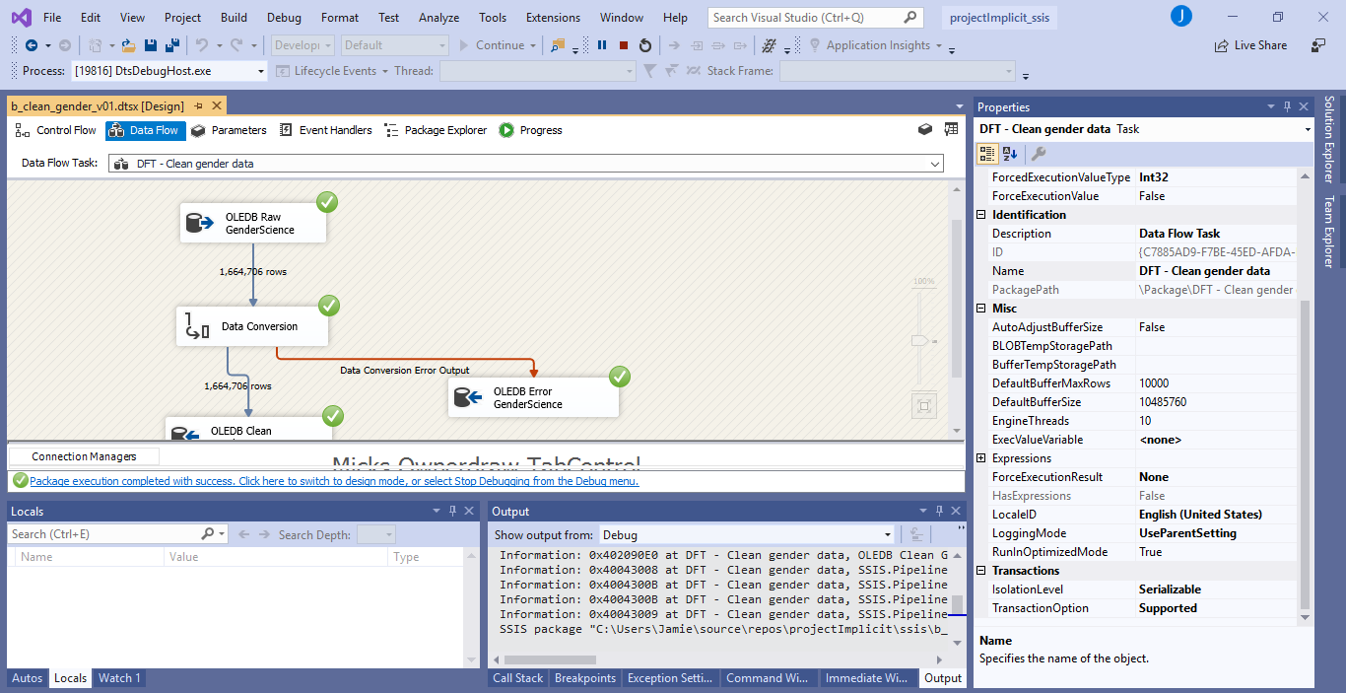
Visual Studio SSIS project package: clean raw data
Our goal is to clean up the raw CSV data and convert the text file into native data types
Control Flow Tasks:
Truncate destination table
Truncate error table
Move cleaned data from raw to clean
Data Flow Task
Read data from source table
Run data conversion
Send error rows into error table
Send valid rows into clean data table
TIP: Ignore numeric conversion errors since some values will be null
Execute package to load clean data into final table

Slide 18
Create Visualizations
POWER BI

Slide 19
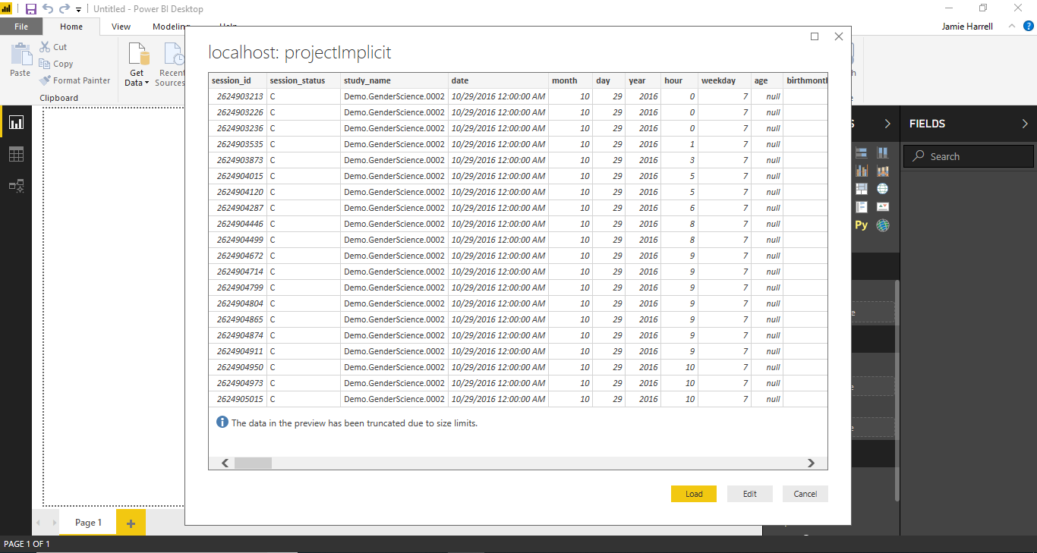
PowerBI: Get data from SQL Server
Goal is to load visualization data into PowerBI to build visualizations
Get Data from SQL server
Specify a query, only load completed surveys (where session_status = ‘C’)
Create visualizations
TIPS:
Use Direct Query instead of Import
If you need to modify data, use SQL
Create measures and hierarchies in PowerBI

Slide 20
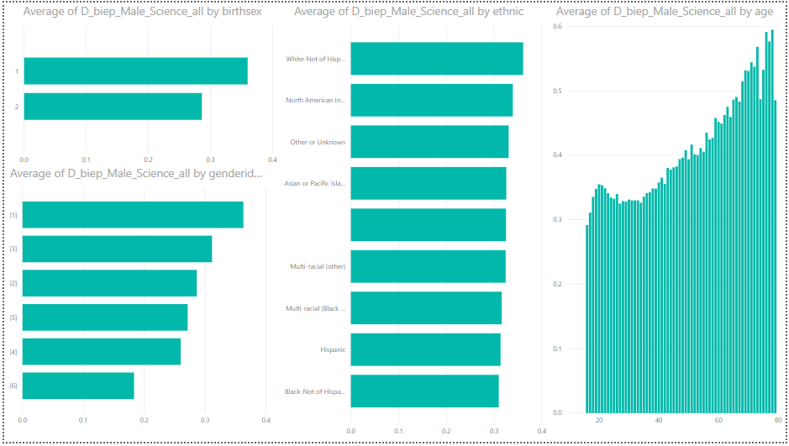
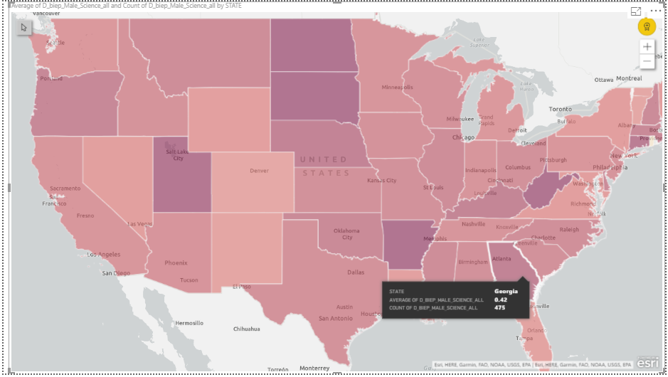
Sample Visualizations – Live PowerBI
Quick Demographics:
Bias by State:

Slide 21

Jamie Harrell, MBA
Jamie is the business intelligence and analytics lead at Emory Goizueta Business School where she earned her MBA in May 2016. She received a degree in Computer Engineering from Georgia Institute of Technology in 1996.
She has been in the hardware and software engineering field for over 20 years, holding VP positions in 2 public companies as well as co-founding and selling two self-funded startups.
Jamie is a frequent speaker, panelist and panel moderator and has participated in events ranging from Emory’s Out In Business panel to the Georgia Academy of Family Physicians’ The Patient Perspective panel. She is the proud parent of two wonderful daughters, Nicole and Anna, and lives in Atlanta, GA.
SSIS & PowerBI File Repository: https://github.com/JamieAnneHarrell/conferences_PowerBI_ProjectImplicit
https://linkedin.com/in/jamieharrellmba
https://jamie.harrell.mba
@jamie.harrell.mba
Notes on copyrights: I do not claim copyright to the ideas and methods presented here; these are common software development concepts. I have tried to cite URLs where information was borrowed from internet sources, and this information is used for educational purposes only.

Slide 22


